Slide 1
Smart Scale Data in SNAP
Rebecca Neiberg for the SNAP Research Group
Senior Biostatistician Department of Biostatistics and Data Science

Slide 2
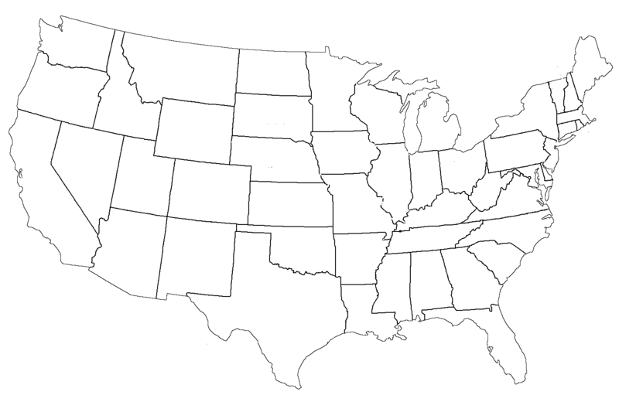
Study of Novel Approaches to Prevention (SNAP)
599 Adults 18-35 years old BMI 21-30
Self-Guided
Small Changes
Large Changes

Slide 3
SNAP Timeline
M4
Y1
Y2
Y3
Y4
4½
Y5
5½
Y6
SNAP
SNAP-Extension
● First 4 months – 10 sessions (Small & Large change)
● Yearly assessments, in-clinic and online
● Two optional refreshers (Small & Large change)
● Monthly emails with zone updates
● Personal scale with manual weight entry
● 4½, 5, 5½ online assessments
● Year 5 phone call
● Year 6 in-clinic and online
● Refreshers
● Monthly emails
● Smart scale automatic upload
● fitbit step tracking

Slide 4
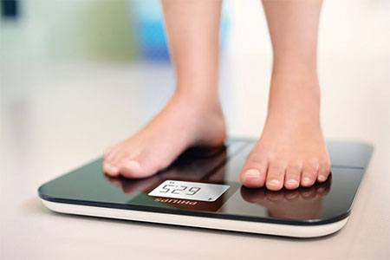
Benefits of BodyTrace™ Smart Scales
Decrease participant burden
Standardized self-weighing
Increase number weights received
Less time in clinics
Retention tool to decrease Lost to Follow-Up
BodyTrace™ eScale, 28 W 39th Street, Room 401, New York, NY 10018

Slide 5
Flow of information
Nightly data
downloads
clinical staff
◦ Data validation
◦ Reports
◦ email & phone feedback
Coordinating Center
◦ Dynamic graphs of weights
participants

Slide 6
Data Cleaning Process
Receive weights from BodyTrace
SAS Process:
● Remove missing or < 85 lbs
● Exclude suspension weights
● Flag >10 lbs from reference
All Data to Validation System for Clinic Staff Review
Invalid
Valid
Exclude
Keep

Slide 7
New Challenges & Considerations
Too many weights to verify
Alternate reference weights over time
Evaluate use for publications

Slide 8
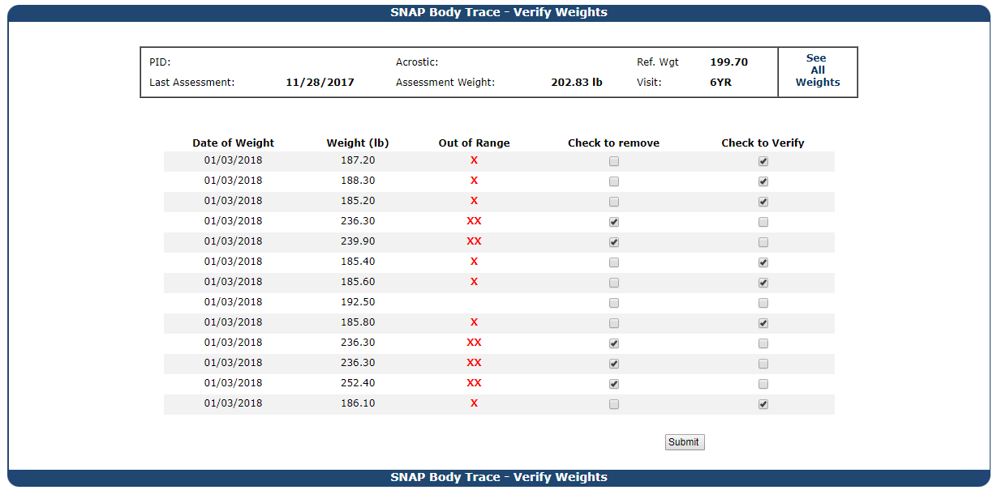
8

Slide 9
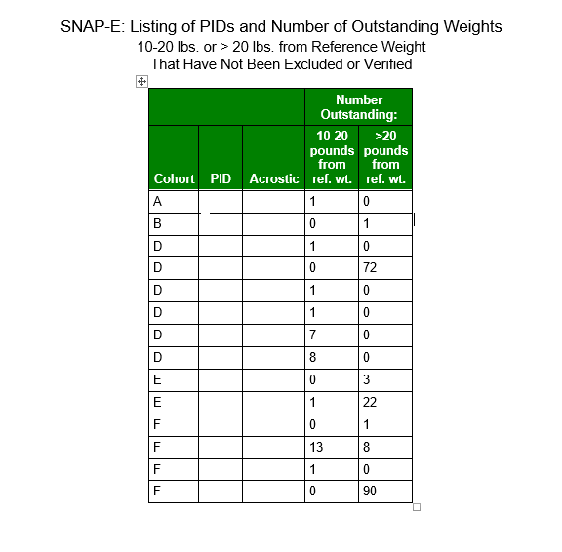
Too many weights to verify: Summary web report

Slide 10
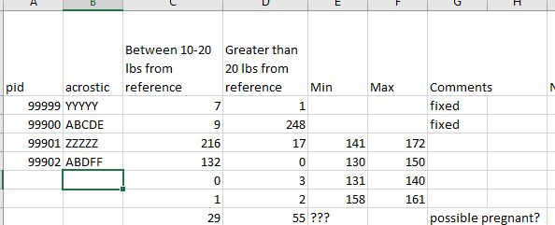
Too many weights to verify: Excel version of web report
Allows for notes and ranges
Alternative reference →Editable min. and max.

Slide 11
Can We Use Smart Scale Data for Publications?
Correlation with in-clinic weights
Self-Weighing Form agreement with Smart Scale frequency
Paper in process

Slide 12
Time between Clinic Weight and Closest Smart Scale Weight at Year 6 Visit
Time between measurements | N(%)
Same day | 99 (29%)
1-7 days | 117 (35%)
1-2 weeks | 26 (8%)
2-4 weeks | 28 (8%)
More than 1 month | 69 (20%)

Slide 13
Test for zero bias :
No significant bias t₍₃₄₆₎=1.08, P=0.2825
Correlation between bias and magnitude:
No significant correlation between bias and magnitude
r=0.013, P=0.8101

Slide 14
Self-Weighing Form
“During the past month, how often did you weigh yourself?”
Never
0 per month
Less than once a month
1 weight / month
Less than once a week
<4
One time a week
~4
Several times per week
8-12
One time each day
~30
Several times per day
>30

Slide 15
Self-Weighing Form vs. Smart Scale Weigh-ins
Self-Weighing Form |  |  | Smart Scale Weigh-ins
Response | Expected Weigh-ins | N | N | Mean ± SD
Never | 0 | 18 | 1 | 6.0 ± .
Less than once a month | 1 | 48 | 24 | 2.4 ± 1.8 ↑
Less than once a week | <4 | 81 | 54 | 3.4 ± 2.8 ≈
Once a week | ~4 | 71 | 58 | 5.7 ± 4.3 ≈
Several times per week | ~12 | 127 | 101 | 13.6 ± 8.8 ≈
One time each day | ~30 | 80 | 65 | 21.9 ± 14.6↓
Several times per day | >30 | 8 | 7 | 26.7 ± 27.2 ↓

Slide 16
Summary
More intensive cleaning for Smart Scale weights than in-clinic
Smart Scale weights are highly correlated with clinical weights
Smart Scales weighing frequency ≈ Self-Weighing form

Slide 17
Acknowledgements
SNAP Participants
Wake Forest University Winston-Salem, NC Coordinating Center
Mark Espeland, PhD
Wei Lang, PhD
Judy Bahnson
Letitia Perdue
Katelyn Garcia
Patty Davis
Julia Robertson
Mark King
Robert Amoroso
Brown University Providence, RI Clinic Site
Rena Wing, PhD
Erica Ferguson
University of North Carolina Chapel Hill, NC Clinical Site
Deb Tate, PhD
Karen Hatley
Kristen Polzien
SNAP Research Group
This study is funded by the NHLBI, R01HL127341

Slide 18
Questions and Suggestions?

